Slide 1
Deep Interest Network for Click-Through Rate Prediction
Advisor: Jia-Ling Koh
Presenter: You-Xiang Chen
Source: kdd 2018
Data: 2019/03/25

Slide 2
Outline
Introduction
Method
Experiment
Conclusion

Slide 3
Introduction
The click-through rate of an advertisement is the number of times a click is made on the ad, divided by the number of times the ad is served.
$$CTR= \frac{Number of click−throughs}{Number of impressions}×100\%$$

Slide 4
Motivation
Deep learning based methods have been proposed for CTR prediction task , but they’re difficulty to capture user’s diverse interests effectively from rich historical behaviors.
Training industrial deep networks with large scales parse features is a great challenge.

Slide 5
Goal
Propose a novel model : Deep Interest Network (DIN) , which designing a local activation unit to adaptively learn the representation of user interests from historical behaviors with respect to a certain ad.
To make the computation acceptable , we develop a novel mini-batch aware regularization.

Slide 6
Outline
Introduction
Method
Experiment
Conclusion

Slide 7
Base Model (Embedding & MLP)

Slide 8
Feature sets in Alibaba

Slide 9
Feature Representation
Encoding vector of feature group
$t_{i}∈R^{K_{i}}$ , $K_{i}$ denotes the dimensionality of feature group $i$
$t_{i}$[j] $∈$ {0,1}
$\sum_{j=1}^{K_{i}}{t_{i}\text{[}\text{j}\text{]}}$ = k
$x$ = [$t_{1}^{T}$, $t_{2}^{T}$,…, $t_{M}^{T}$]
$\sum_{i=1}^{M}{K_{i}}$ = K , K is dimensionality of entire feature group

Slide 10
Embedding layer
Embedding dictionary
$W^{i}=[w_{1}^{i},w_{2}^{i},…,w_{j}^{i},…,w_{K_{i}}^{i}]$ $∈$ $ℝ^{D×K_{i}}$
Embedding vector
$$e_{i}=w_{j}^{i} ,$$
$${ t}_{i} is one−hot$$
$$\left\{e_{i_{1}}^{i},e_{i_{2}}^{i},…,e_{i_{k}}^{i} \right\}=\left\{w_{i_{1}}^{i},w_{i_{2}}^{i},…,w_{i_{k}}^{i}\right\} ,$$
$$t_{i} is multi−hot$$

Slide 11
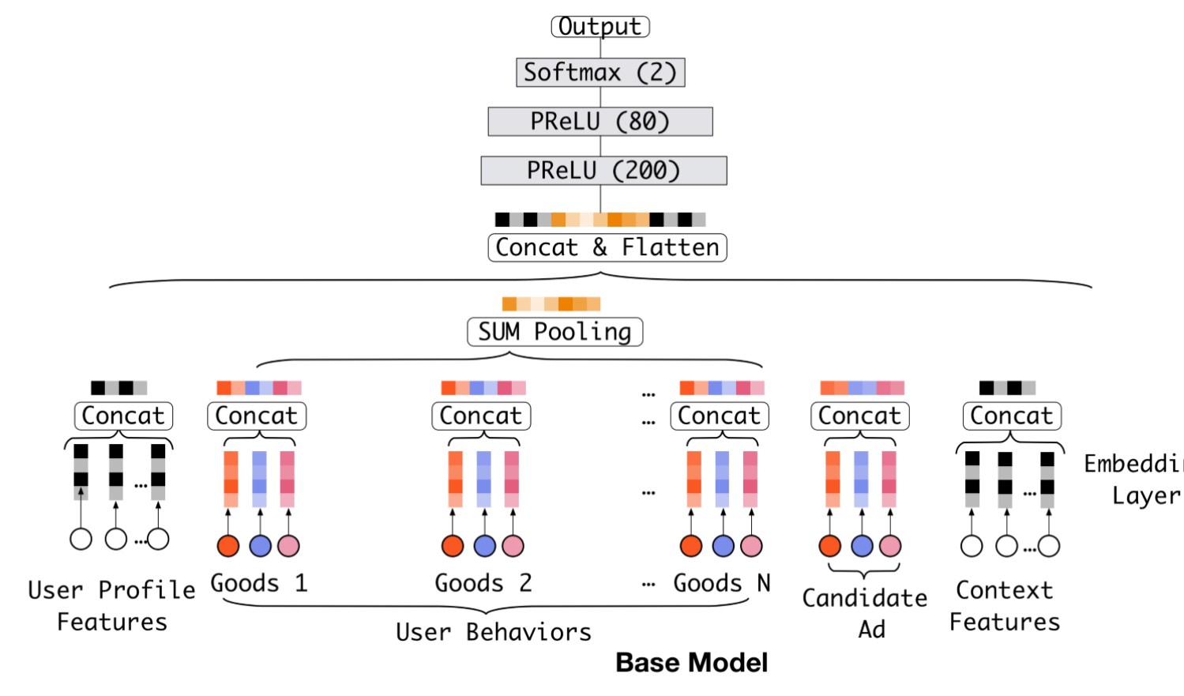
Pooling & Concat layer
$$e_{i}=pooling(e_{i_{1}},e_{i_{2}},…,e_{i_{k}})$$

Slide 12
Objective function
Negative log-likelihood function

Slide 13
Deep Interest Network

Slide 14
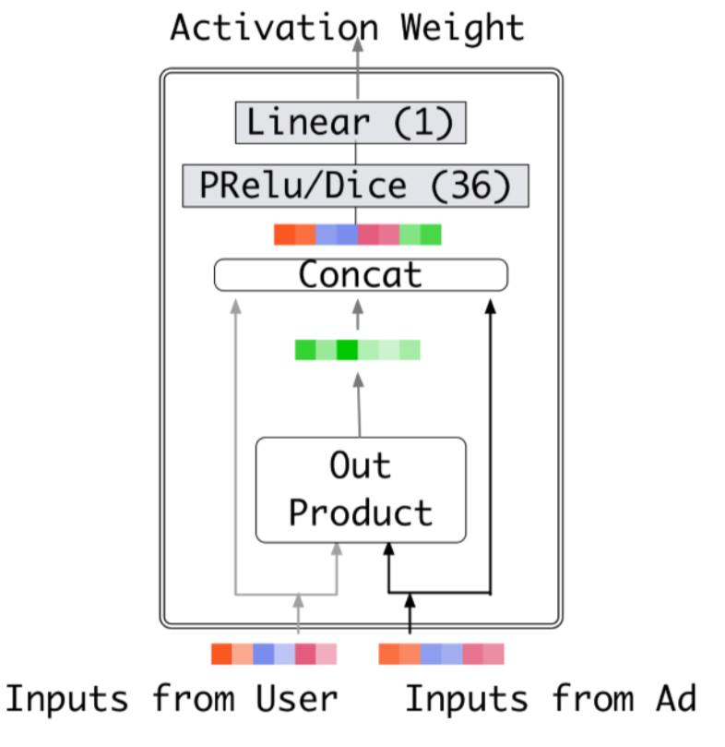
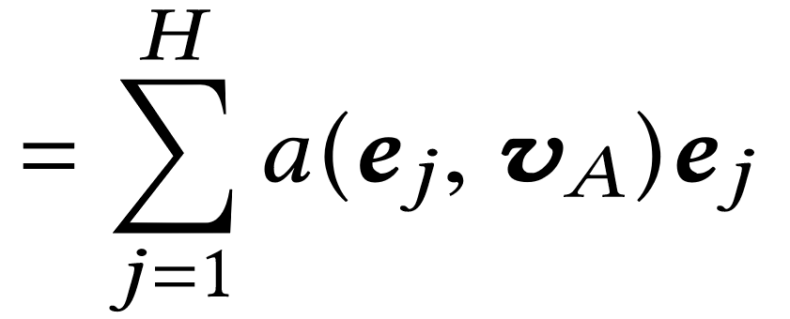
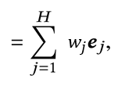
Activation Unit

Slide 15
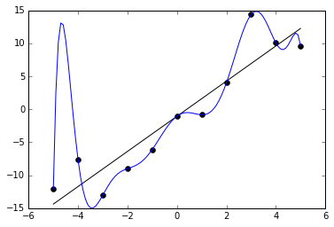
L2 Regularization
$$y=a+bx+{cx}^{2}+{dx}^{3}$$
$$y=a+bx+{0x}^{2}+{0x}^{3}$$
$$J\left(θ\right)={[y_{θ}\left(x\right)−y]}^{2}+[θ_{1}^{2}+θ_{2}^{2}+…]$$
$$J\left(θ\right)={[y_{θ}\left(x\right)−y]}^{2}+λ\sum{θ_{i}^{2}}$$

Slide 16
Mini-batch Aware Regularization
Expand the regularization on W over samples
Transformed into following in the mini-batch aware manner

Slide 17
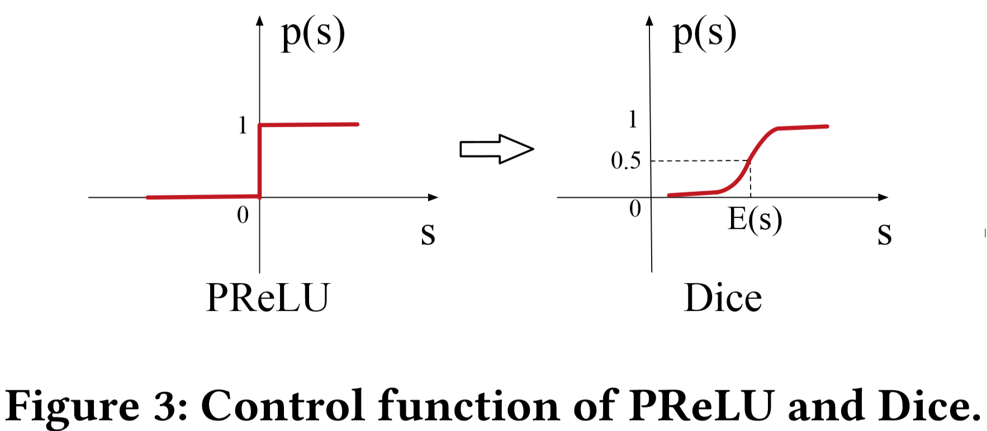
Data Adaptive Activation Function
PReLU activation function
Dice

Slide 18
Outline
Introduction
Method
Experiment
Conclusion

Slide 19
Datasets

Slide 20
Train & Test Loss
Notes:
虛線 Overfitting
深綠色:沒有正規化
Training with good id is better than without (weighting)

Slide 21
Test AUC

Slide 22
Performance

Slide 23
Best AUCs of Base Model with different regularizations (comparing with first line)
Notes:
有無使用 good_ids 和 正規化
Dropout 隨機丟掉 50% 的feature
Filter : 把很常出現的feature 移出，這邊把前2000萬筆常出現的feature移出，對剩下的做reg
Difacto : 另一篇提到的正規化方法，概念是較常出現的feature 少做正規化。
MBA : 我們的方法 mini batch aware

Slide 24
Model Comparison on Alibaba Dataset with full feature sets

Slide 25
Illustration of adaptive activation in DIN

Slide 26
Outline
Introduction
Method
Experiment
Conclusion

Slide 27
Conclusion
A novel approach named DIN is designed to activate related user behaviors and obtain an adaptive representation vector for user interests which varies over different ads.
Two novel techniques are introduced to help training industrial deep networks and further improve the performance of DIN.

